Slide 1
12TH OCTOBER MEETING
Read over the papers from the reading list
Mihailescu et al., (2020): Spatial variations of low mass negative ions in Titan’s upper atmosphere.
Desai et al., (2017): Carbon Chain Anions and the Growth of Complex Organic Molecules in Titan's Ionosphere.
Downloaded Keras through Tensorflow and read through some of the documentation for Keras

Slide 2
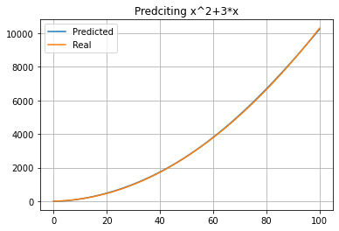
26TH OCTOBER MEETING
Followed YouTube tutorials for making our own neural networks.
Made linear regression model in Python using Keras.
Made univariate models to predict sin waves and multivariate models to predict quadratics

Slide 3
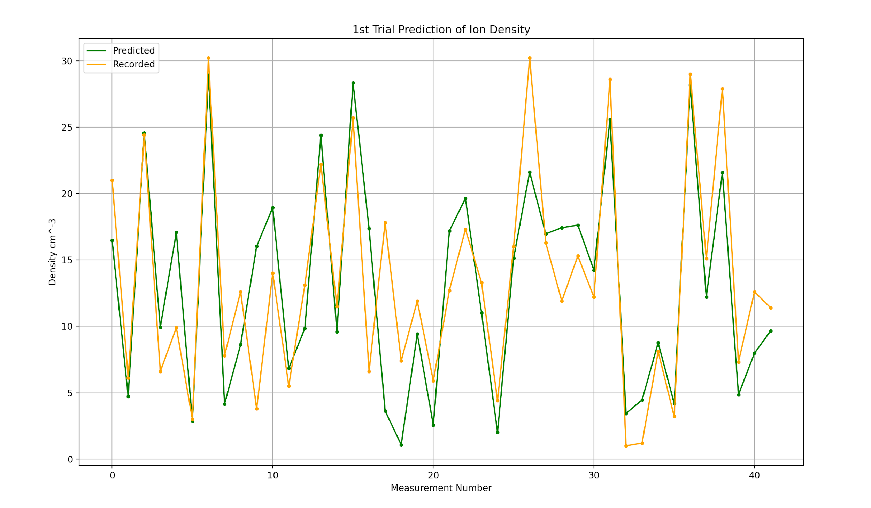
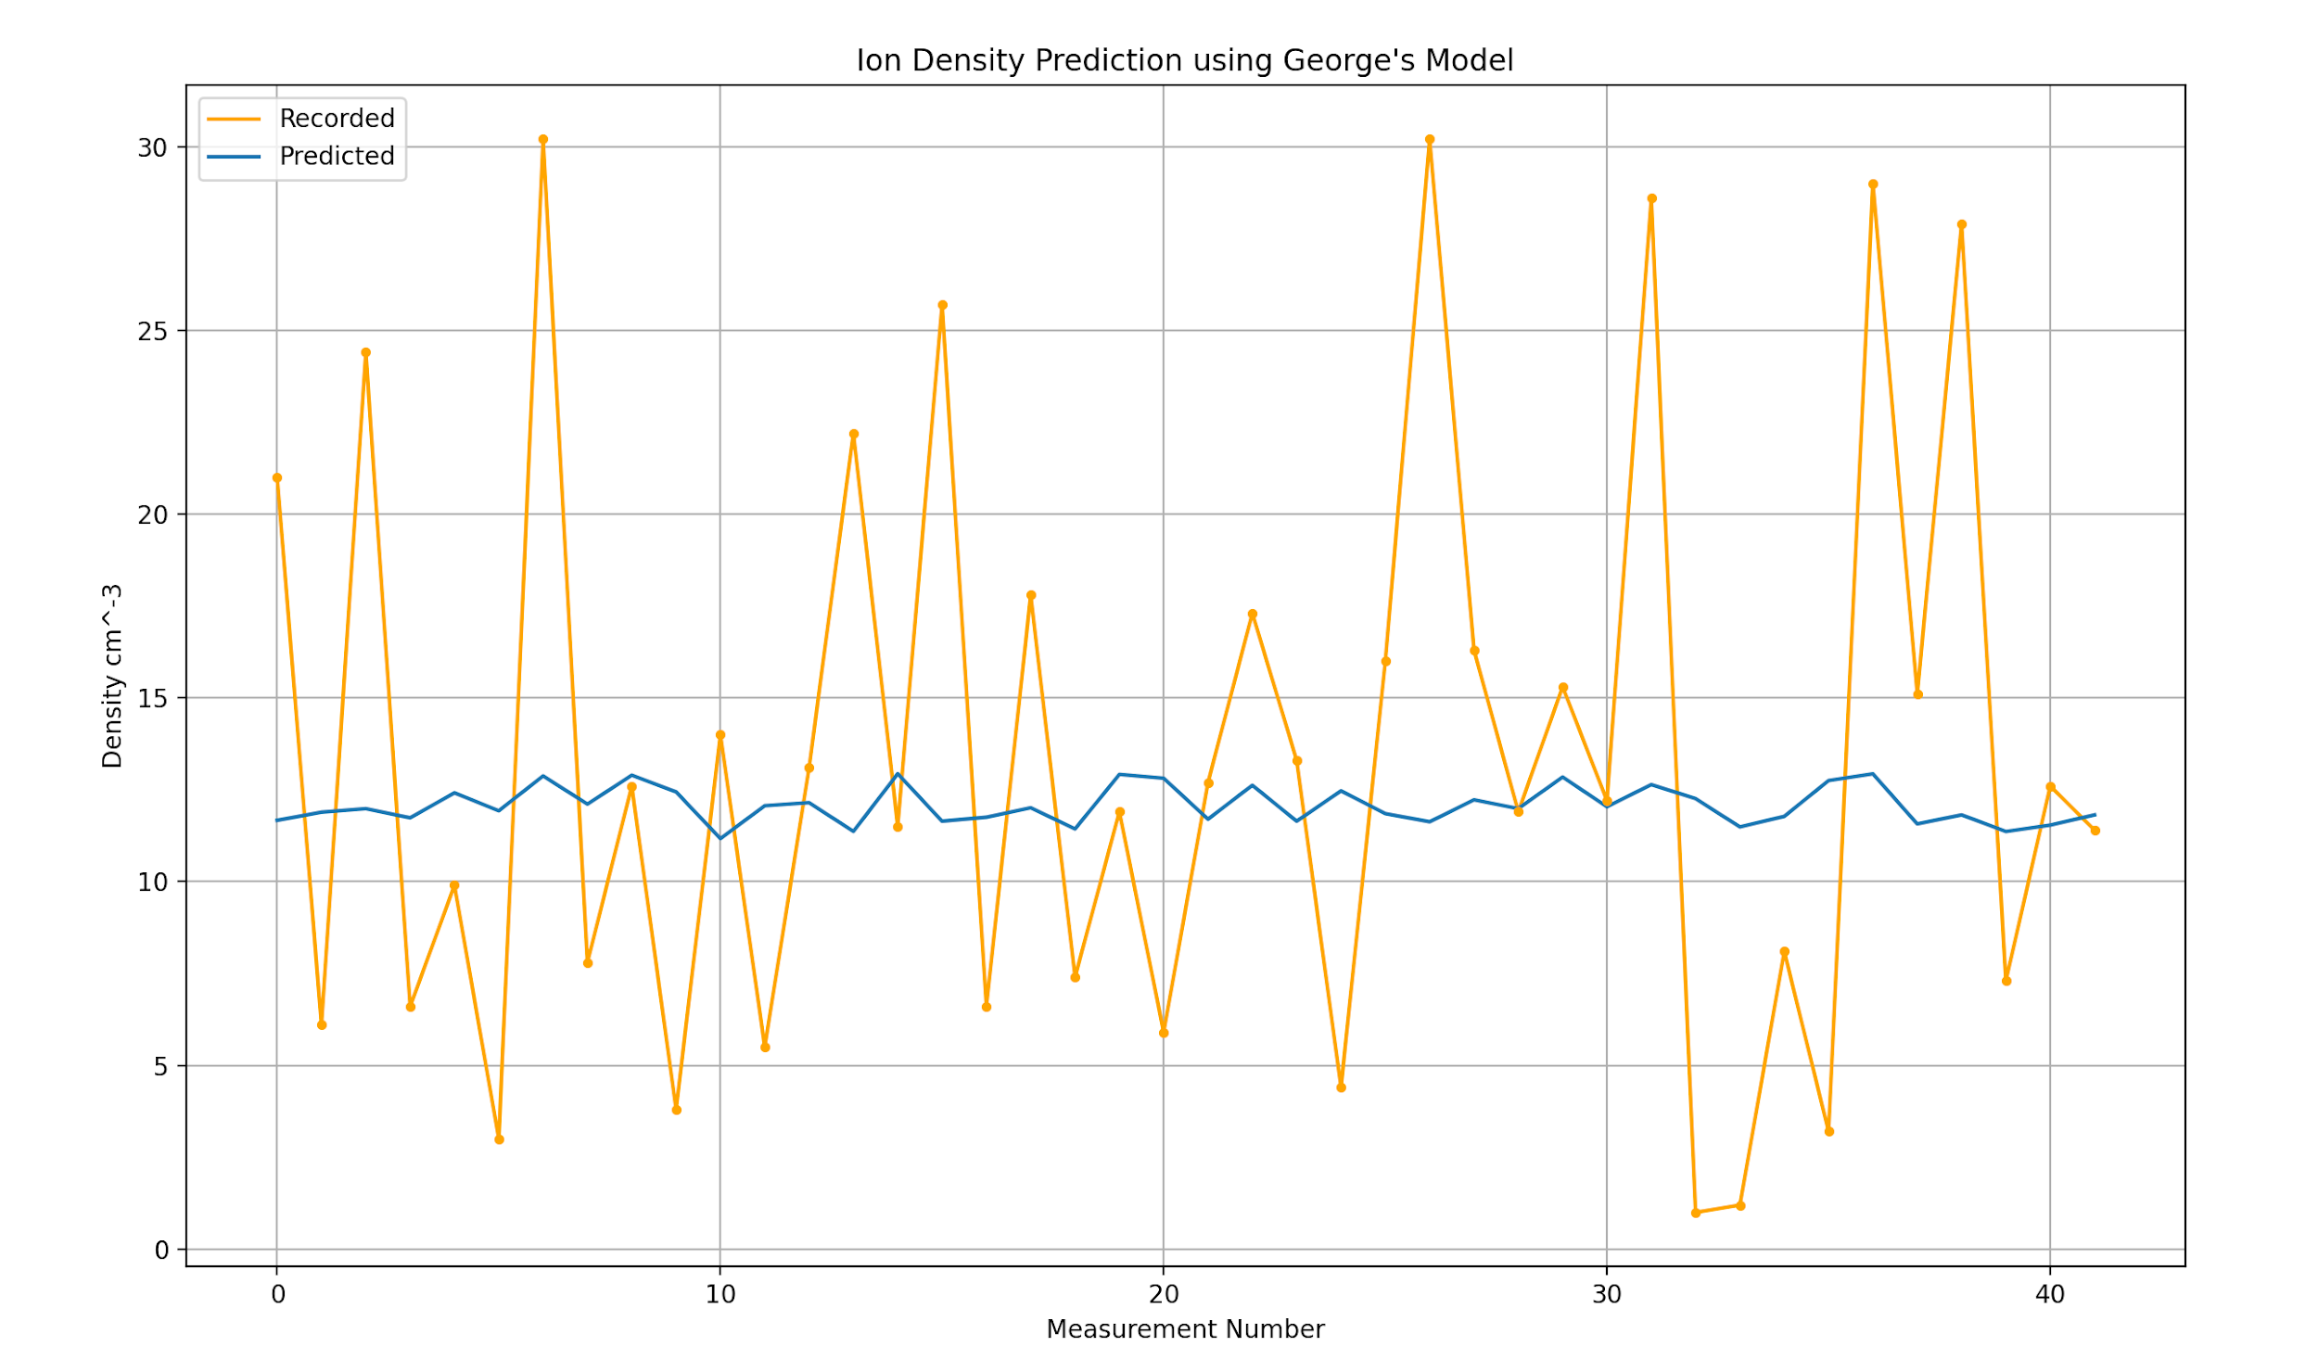
2nd November Meeting
Changed the LSTM model to work with the processed Cassini data.
Currently a basic model with one LSTM layer (50 nodes) and a Dense layer (1 node)
Implemented training and test sets to measure performance of the model (80/20 split)
Looked at George’s model to compare performance between models
To do:
Improve model by adding layers/ other modifications
Propagate uncertainties

Slide 4
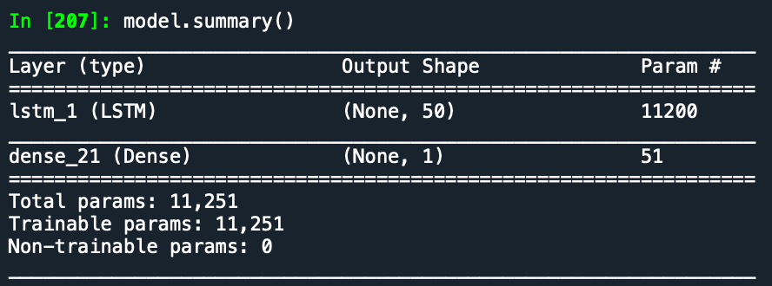
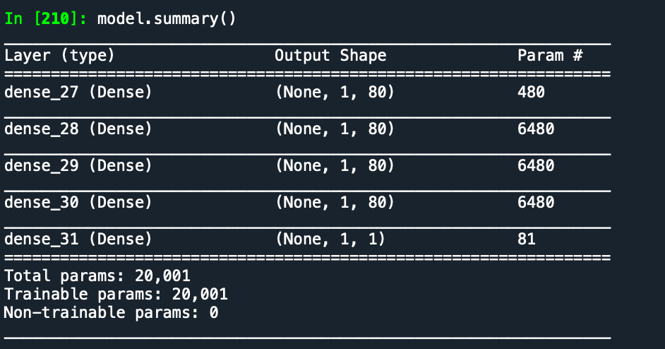
Models Used
Our model consisting of 1 LSTM layer and 1 Dense layer
George’s model consisting of 5 Dense layers

Slide 5
9 November Meeting
Tested if including electron density and electron temperature as variables in the model improves prediction accuracy
Electron density significantly improves prediction accuracy and electron temperature either slightly improves accuracy or has no effect at all
Converted longitude and latitude to sin functions to fulfill boundary conditions
The algorithm will now recognise that 180° longitude is the same as -180°, same for 90° and -90° latitude
This change noticeably reduces extreme predictions such as predictions of negative ion densities
Implemented a Random Search algorithm to find the combination of hyperparameters that reduces prediction error

Slide 6
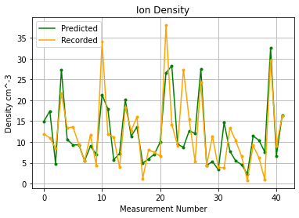
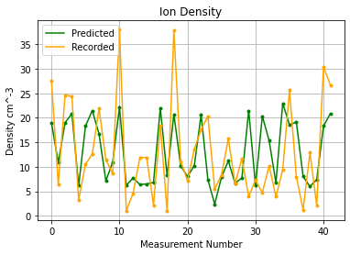
Prediction with/without Electron Data

Slide 7
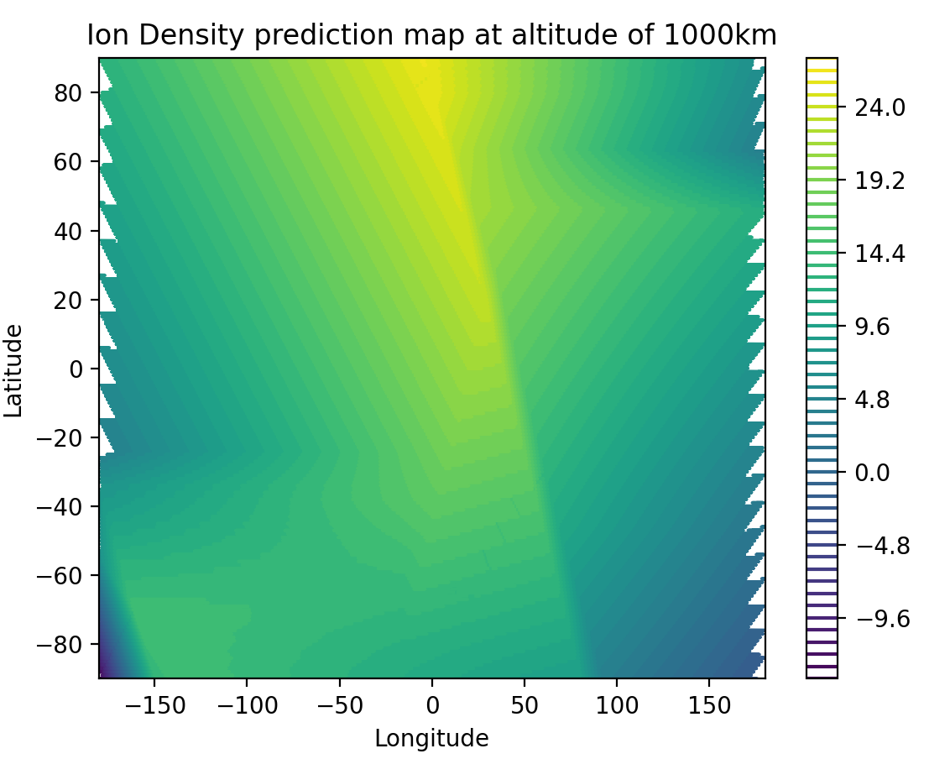
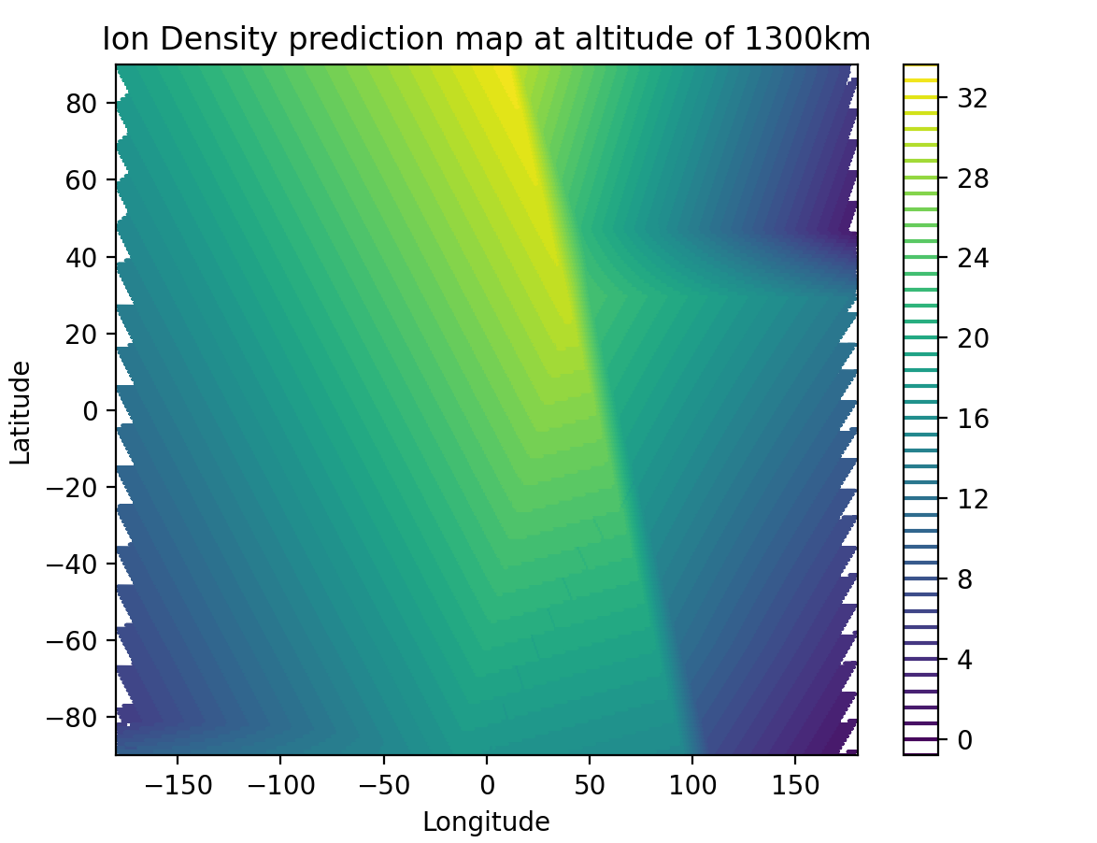
Initial Contour Maps
Predicted ion density at a set altitude at various longitudes and latitudes

Slide 8
18th Nov Meeting
Used the GridSearch algorithm to find the optimal loss function, optimizer, nodes, and activation function
Took around 4 hours to run, was left overnight to find results
Results of GridSearch
The algorithm recommended an ‘MSE’ loss function, 50 nodes, ‘relu’ activation function, and ‘SGD’ optimizer
Running this combination of hyperparameters, the results were much worse, indicating that the gridsearch did not work
Next Steps
Manually change the hyperparameters to find the parameters that reduce prediction error compared to the test set

Slide 9
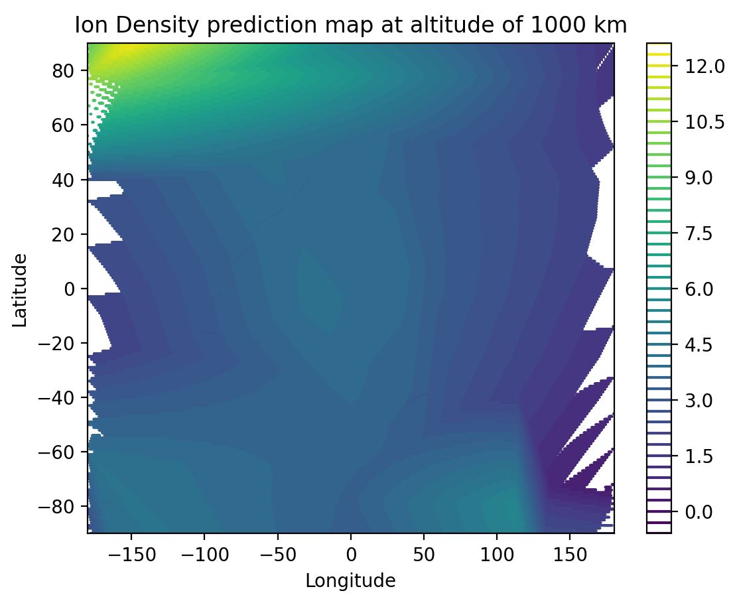
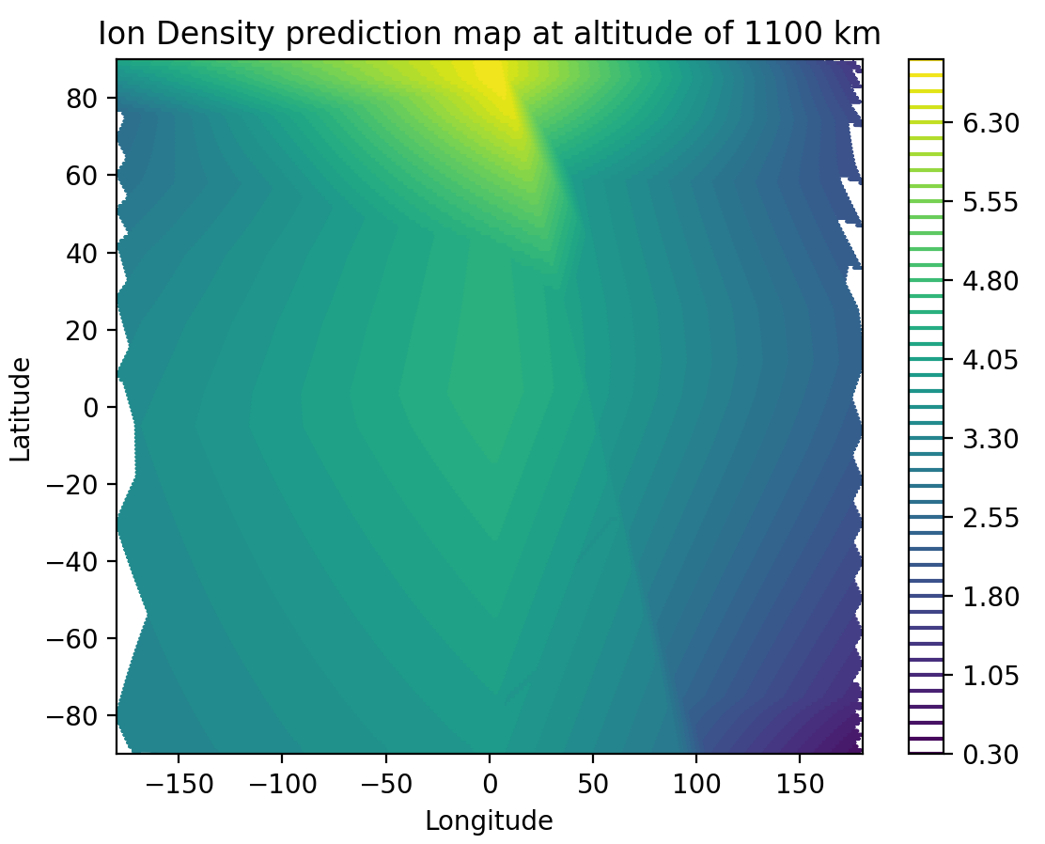
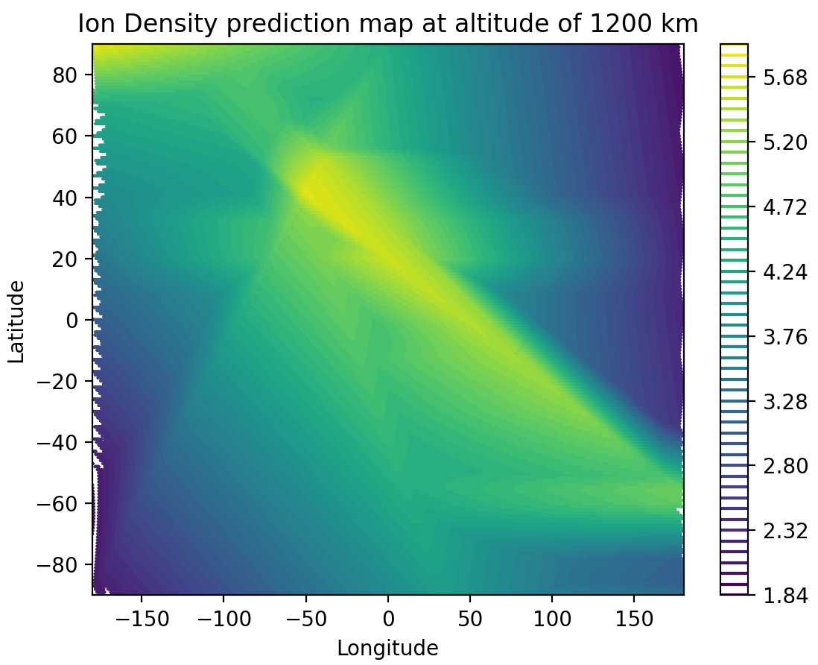
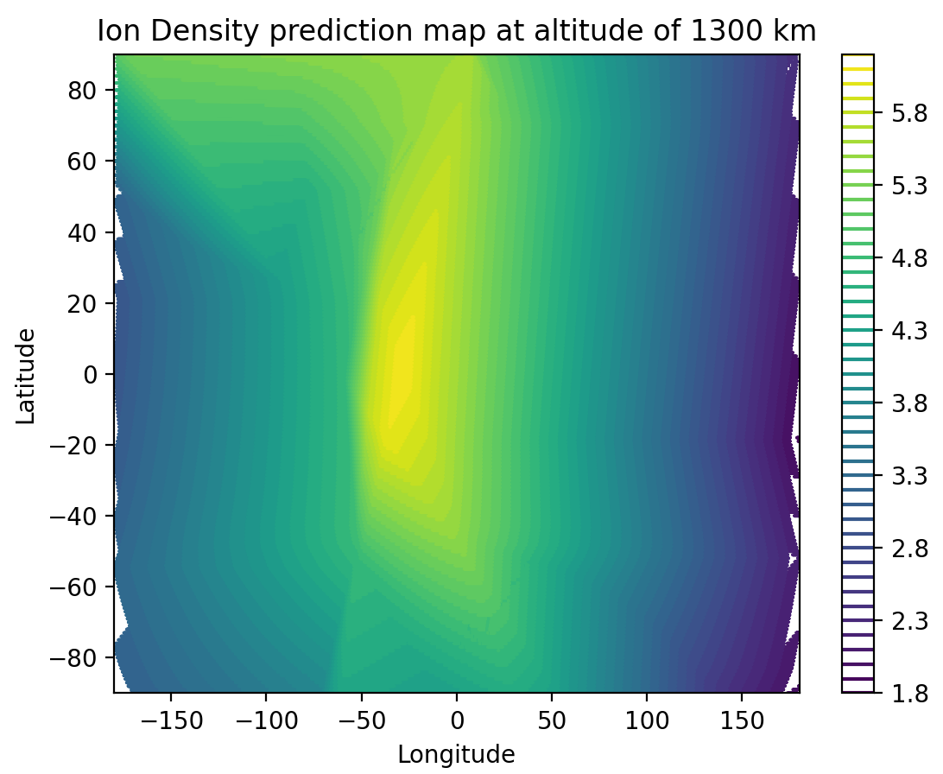
2nd Trial of Contour Plots
For each plot, the model was run 5 times to predict the ion densities at a given altitude.
The average prediction at each altitude was then plotted.
Negative predictions of densities have been fixed.
Trained using 100% of data.

Slide 10
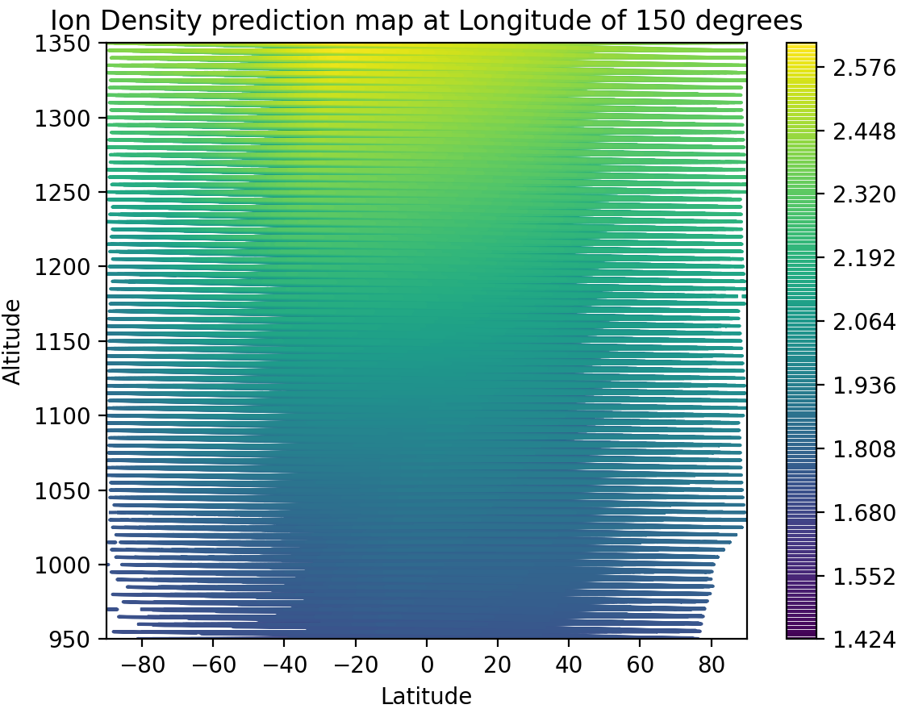
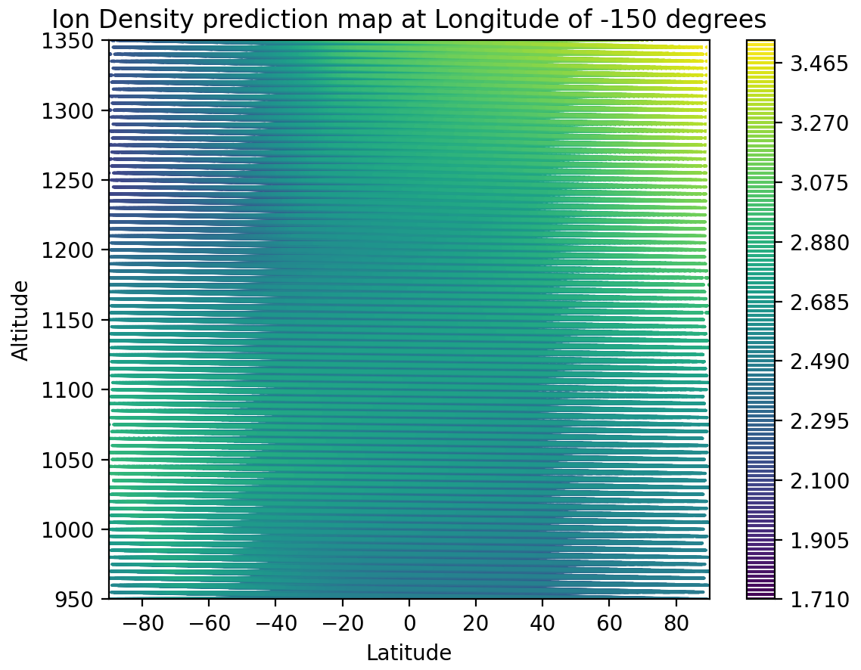
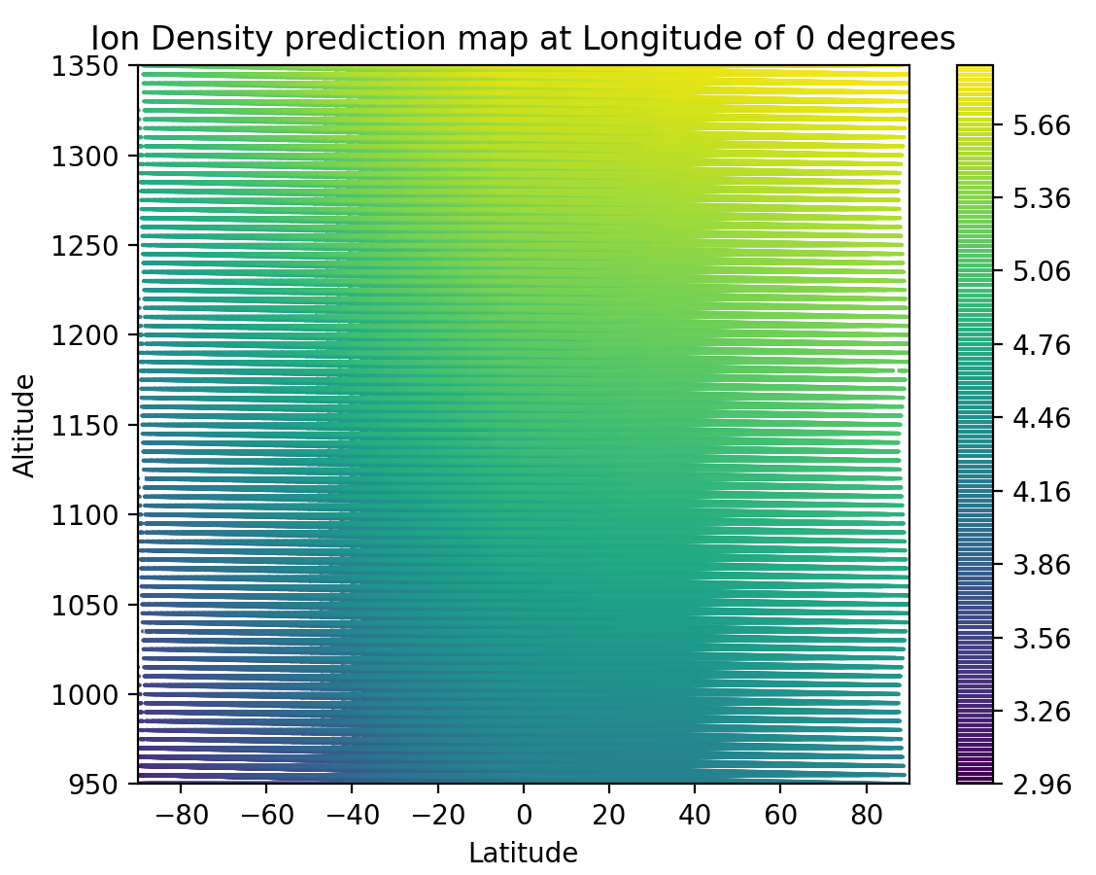
Sliced Contour Plots
For each plot, the model was run 5 times to predict the ion densities at a given longitude
Altitude against Latitude
The average prediction at each altitude was then plotted.
Trained using 100% of data.
Choice of step size led to gaps in data, so need to decrease (longer computational time).
Expected higher densities at lower altitudes, hence need to identify some more problems.

Slide 11
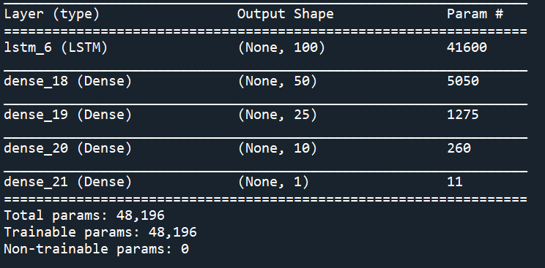
22nd Nov Meeting
Worked on improving the model by changing the number of nodes, optimiser, loss function, and number of layers
Significant improvements can be seen in the consistency of the predictions when running the model multiple times (due to the number of layers)
Improvements in predicting peaks compared to before (due to optimiser and loss function)
New Model:

Slide 12
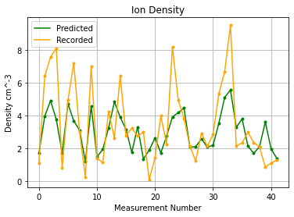
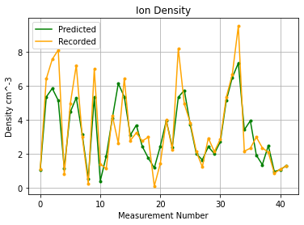
New Model Example
Ran both models once for 2000 epochs
Old Model New Model

Slide 13
30th November Meeting: Parameter Choices & Errors
Made plots for epochs, layers, nodes, activation, loss, and optimiser vs error
Conducted the experiment for models with and without the electron data
The error was found by running the model 5 times and taking the average error. We recorded mean absolute percentage error as well as mean-squared error
The error was found by training the model on 80% of the data and comparing predictions to a test set

Slide 14
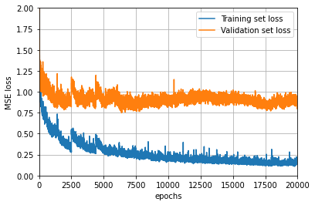
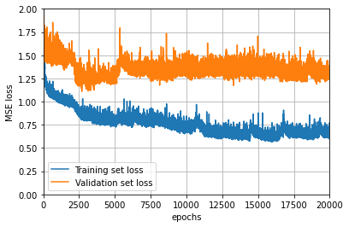
Number of Epochs
The plots show how the number of epochs impacts the training fit and the actual precision error (validation set loss) for a model with all 5 inputs (top) and just 3 spatial inputs (bottom)
Initially, both training and validation set improve, but after a while only validation set accuracy improves
This suggests that after this point, training further does not benefit the model
In some cases, the validation set error is worse for higher epochs, this is known as overfitting

Slide 15
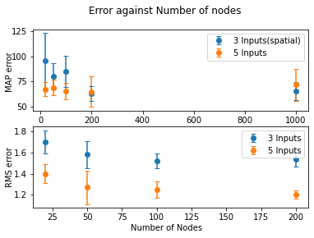
Number of Nodes
Increasing the number of nodes improves performance up to ~100 nodes
After this point, there is no significant effect when changing the number of nodes

Slide 16
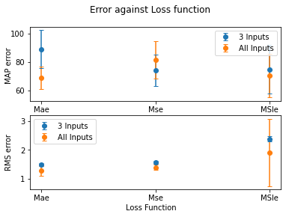
Loss Function Error
Mean average error is slightly better than mean-squared error.
Mean-squared log error is by far the worst and gives inconsistent results

Slide 17
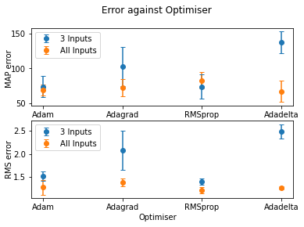
Optimiser Error
The results are not consistent between the 3 input and the 5 input models. For the 5 input models, Adagrad and Adadelta perform much worse than the others
Overall, adam or RMSprop provide good results for the 3 and 5 input models

Slide 18
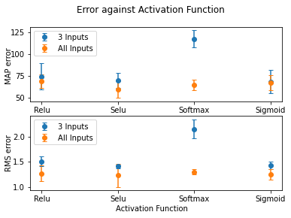
Activation Function Error
All the activation functions except softmax provide similar results
Selu gives the lowest rms for the 5 input model whereas sigmoid gives the lowest rms for the 3 input model

Slide 19
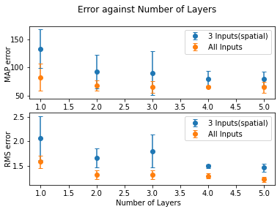
Number of Layers
Increasing the number of layers gives better results and decreases the variance between predictions between models
Increasing the number of layers beyond 4 does not seem to provide any better results

Slide 20
Heat Maps using Chosen Parameters
Parameters chosen:
Loss function: Mean Absolute Error (MAE)
Optimiser: RMS Prop
Activation Function: Scaled Exponential Linear Unit (SELU)
Number of Layers: 1 LSTM layer 4 Dense Layers
Number of Epochs: 200 (better for more but limited due to computational time)
Number of nodes: (In order from LSTM layer to Dense layers) (100, 50, 25, 1)

Slide 21
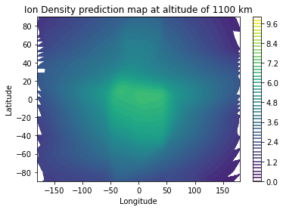
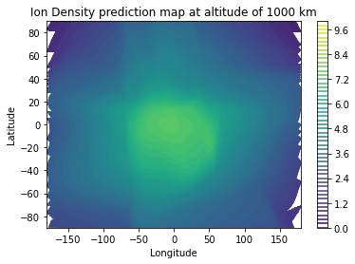
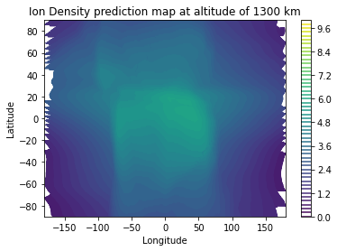
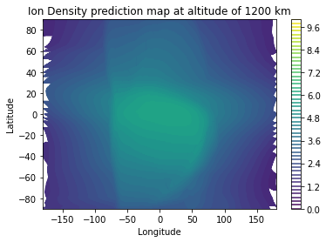
Latitude vs Longitude at chosen altitudes

Slide 22
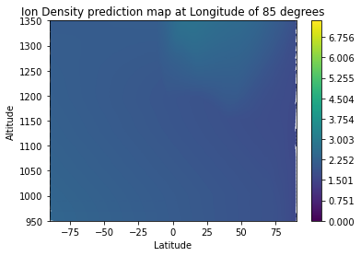
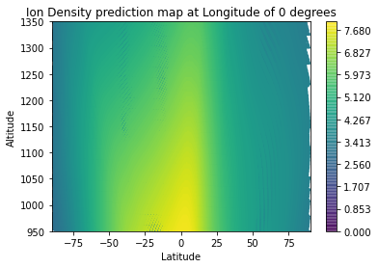
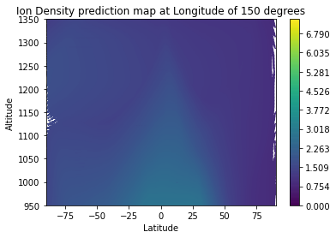
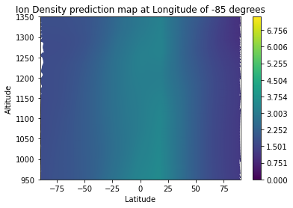
Latitude vs Altitude (to scale)

Slide 23
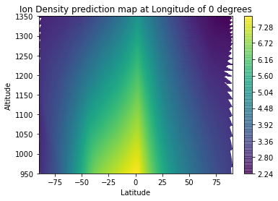
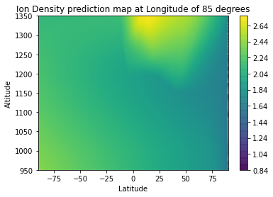
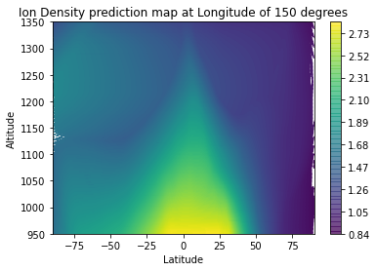
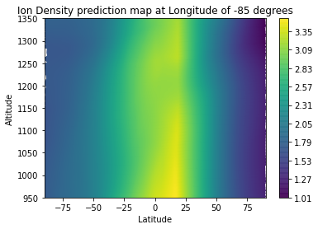
Latitude vs Altitude (Colour Adjusted)

Slide 24
7th November Meeting
Completed the tasks for this meeting:
Made latitude vs longitude plots with individual colourbar range
Produced results using models trained at higher number of Epochs (2000)
Researched into next step to find a way to enhance the model

Slide 25
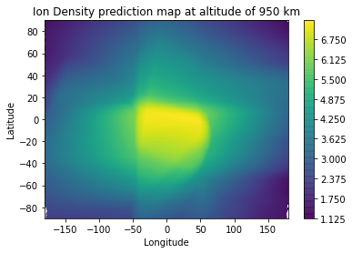
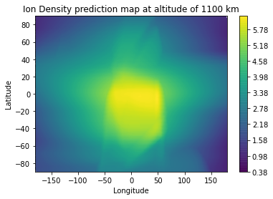
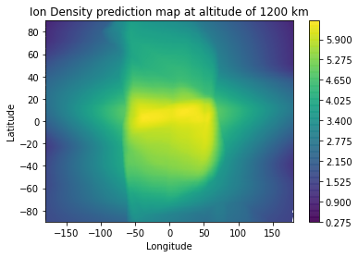
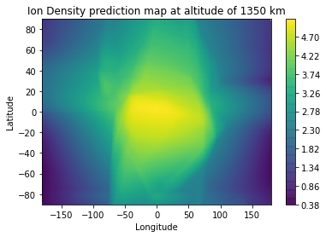
Lat v Long plots with Adjusted Colour-bars

Slide 26
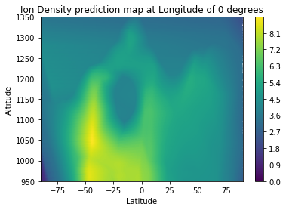
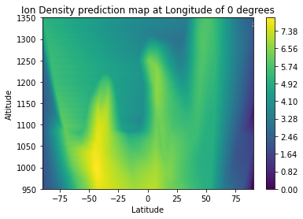
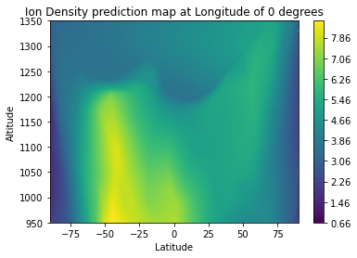
2000 Epoch models
Performed predictions using standard parameters at 2000 epochs with a starting point of 200 nodes on the LSTM layer
prediction over 1 cycle

Slide 27
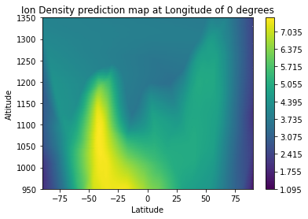
Average of 2000 epoch models over 5 cycles

Slide 28
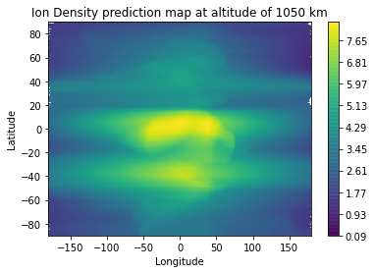
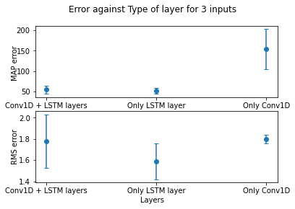
Conv1D Layer
Convolutional Neural Networks (CNNs) are used to find features within a dataset using a ‘filter’ that highlights important aspects within the data to the model.
Here, a 1D convolution was used with 200 nodes, with a Selu activation function
The convolution performed worse, but there is a lot of potential to improve

Slide 29
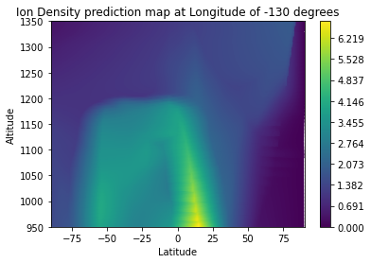
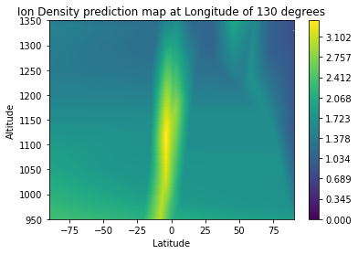

Sample Results
These results are for a basic convolutional layer + LSTM layer and were run once with 2000 epochs

Slide 30
Sample Lat v Long result
Sample prediction at altitude of 1050km:
using 1LSTM and 1Conv1D layer
averaged over 5 cycles
200 starting nodes
2000 epochs

Slide 31
Further Steps
Could look into how to create a better CNN by improving existing model
There are many parameters that can be improved, for example more convolutional layers, pooling layers etc.
Can create a new model using a 3D convolution neural network instead of the 1D layer used here
This network would take inputs in a different form, so would take more time to make.
Make other improvements that do not involve CNNs.

Slide 32
11th December Meeting
Epoch Analysis:
To investigate shifting peak from previous results
Performed error analysis on varying number of epochs
Generated predictions for both types of contour plots
Latitude vs longitude at 1000 km and 1125 km altitudes.
Altitude vs latitude at 0 degrees longitude.

Slide 33

Error against number of Epochs
Error decreases steadily until about 1000 epochs, and there is another slight decrease from 1000 to 1500 epochs.
From 1500 to 2000 epochs there seems to be overfitting as error increases slightly again

Slide 34

Error against number of Epochs (log scale)
Can see that error seems to linearly decrease with an exponentially increasing number of epochs.
Stops decreasing at ~1500 epochs and starts to increase past this value
This is likely to be the limit at which overtraining occurs

Slide 35

80/20 train-test split with chosen parameters
Parameters that would produce optimal prediction:
Loss function: Mean Absolute Error (MAE)
Optimiser: RMS Prop
Activation Function: Scaled Exponential Linear Unit (SELU)
Number of Layers: 1 LSTM layer 4 Dense Layers
Number of Epochs: 1500
Number of nodes: (In order from LSTM layer to Dense layers) (100, 50, 25, 1)

Slide 36






1000 km at 20 epochs: (largely inconsistent)
Average of 5

Slide 37






1000 km at 200 epochs: (slightly more consistent shape)
Average of 5

Slide 38






1000 km at 1000 epochs: (more complexities in the prediction)
Average of 5

Slide 39






1000 km at 1500 epochs: (more complexity but rather inconsistent)
Average of 5

Slide 40






1000 km at 2000 epochs: ( )
Average of 5

Slide 41


Varying Epochs at 1000 km altitude (averages)
20 epochs
50 epochs
200 epochs
500 epochs
1000 epochs
1500 epochs

Slide 42






Varying Epochs at 1125 km altitude (averages)
20 epochs
50 epochs
200 epochs
500 epochs
1000 epochs
1500 epochs

Slide 43






0 Degrees Longitude at 20 Epochs
Average of 5

Slide 44






0 Degrees Longitude at 200 Epochs
Average of 5

Slide 45






0 Degrees Longitude at 1000 Epochs
Average of 5

Slide 46






0 Degrees Longitude at 2000 Epochs
Average of 5

Slide 47


Varying Epochs at 0 degrees longitude (averages)
20 epochs
200 epochs
500 epochs
1000 epochs
1500 epochs
2000 epochs

